Slide 1
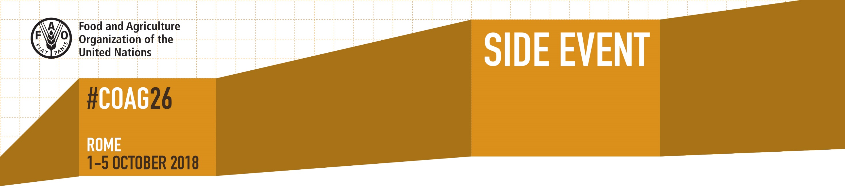
The rise of the seed-producing
cooperative in West and Central Africa:
A viable path towards improving
access to quality seeds in the region
12:30 – 14:00 | Iran Room

Slide 2

The Rise of the Seed-producing
Cooperative
FAO, 3 October 2018

Slide 3
The Access to Seeds Index benchmarks seed companies on their performance to improve access to quality seeds for smallholder farmers
November 2018
South and Southeast Asia
February 2019
Western & Central Africa
February 2019
Eastern & Southern Africa

Slide 4
For Western & Central Africa, just looking at seed companies is not enough: seed-producing cooperatives have a wider coverage
Coverage global seed companies
Coverage regional seed companies
Coverage seed-producing cooperatives
Senegal
Ghana
Guinea
Sierra Leone
Mali
Liberia
Côte d’Ivoire
Burkina Faso
Togo
Benin
Niger
Nigeria
Cameroon
Chad
CAR
DR Congo
Senegal
Mali
Côte d’Ivoire
Burkina Faso
Ghana
Togo
Niger
Nigeria
Cameroon
Gabon
Senegal
Mali
Côte d’Ivoire
Burkina Faso
Ghana
Nigeria
Presence of more than two
global seed companies (ATSI 2016)
Presence of regional seed companies with activities
in breeding, production and distribution (ATSI 2018)
Presence of formally recognized seed-producing cooperatives (ATSI 2018)

Slide 5
To better understand the role of cooperatives, we studied
54 leading seed-producing cooperatives across the region
Per country, three leading
cooperatives were selected
using four criteria:
number of members;
seed volumes;
geographic coverage; and
peer recognition

Slide 6
Key findings shine a new light on the role of
seed-producing cooperatives
Cooperatives are part of the formal seed sector
They are formally recognized as seed producers, produce certified seeds
Cooperatives introduce new improved varieties
Cooperatives partner with research institutes to test, select and release new varieties
Cooperatives distribute on a national scale
Through partnerships with seed companies,
NGO’s or government agencies
Cooperatives work on a variety of crops
Including crops not often found in the portfolio
of seed companies
Crops found in portfolio of
selected cooperatives

Slide 7
National laws and policies have been supportive
of the rise of seed-producing cooperatives

Slide 8
Business model analysis showed advanced practices
in R&D, production and marketing
Nearly 50% partner with research institutes to test, select and release new varieties
Over 90% produce certified seed
Nearly 50% work with partners to distribute at national scale

Slide 9
Performance of cooperatives differs in the region:
strong examples identified in four countries
Strong examples include
Advanced partnerships with research agencies
Advanced levels of seed production
Distribution partnerships to reach national scale

Slide 10
Some examples
Coopérative Agricole de Bama
Burkina Faso
200 seed producers operating in irrigated land
Partners with companies
to sell seed at national level and abroad
Union Madda Ben de Falwel
Niger
Partnership with ICRISAT resulted in release of
4 new millet varieties
Also produces early generation seeds
Jirkur Seed Cooperative Society
Nigeria
Only supplier of certified
seeds in Borno State
Has grown from 10 to 200 members in 5 years

Slide 11
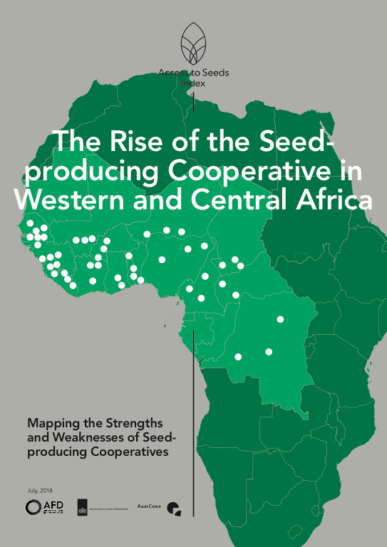
Full study can be found on the website
of the Access to Seeds Index
www.accesstoseeds.org

Slide 12
Panel discussion
Ms. Nancy Wakawa Mohammed, executive director Jirkur Seed, Nigeria
Yacouba Tanda, seed production technician, Madda Ben de Falwel, Niger
Michel Vabi Boboh, country manager, ICRISAT, Niger
Ernest Asiedu, Chief of Party West Africa Seed Program, CORAF, Senegal
Yacouba Diallo, regional consultant Access to Seeds Index, Mali
Hans Dreyer, director Plant Production and Protection Division, FAO
Hans Hoogeveen, Ambassador of
The Netherlands to FAO (chair)
The Rise of the
Seed-producing
Cooperative

